Slide 1

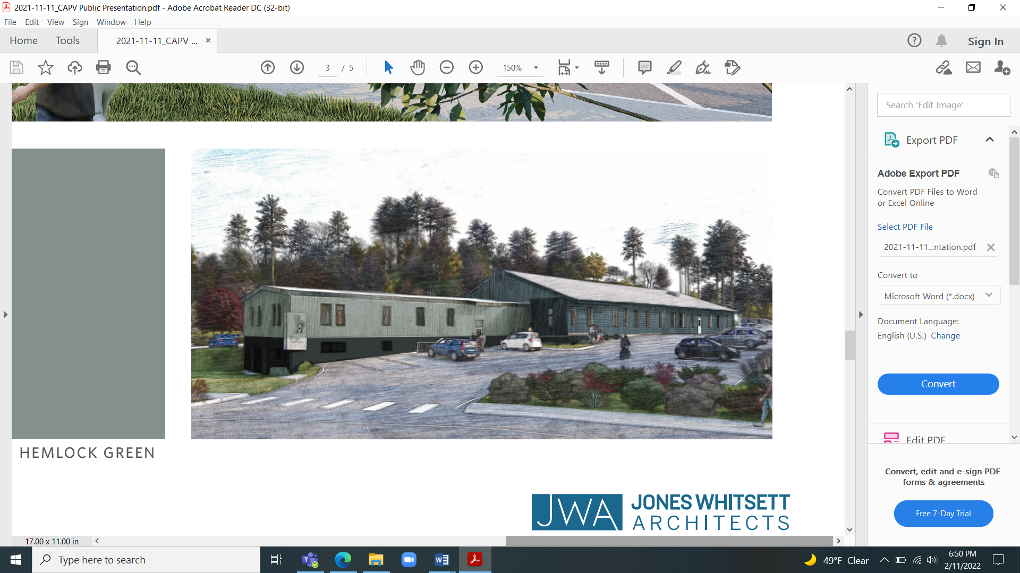
Community Resource Center @ River Street

Slide 2
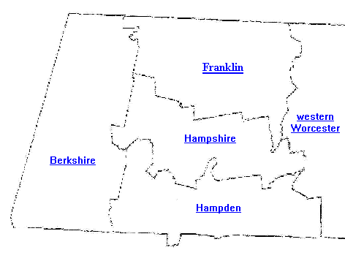
Regional Impact
Community Action serves more than 28,000 people via more than 40 programs every year
We are one of the largest employers in Franklin County with more than 300 employees
A 1,900 square mile, mostly rural service area in Franklin & Hampshire Counties & parts of Hampden, Berkshire, & Worcester Counties

Slide 3

Community Resources & Advocacy
We provide information and referral assistance over the phone every weekday to several thousand callers per year
We assisted over 800 households per year in Franklin and Hampshire counties and the North Quabbin region through coordinating supportive services to help stabilize their households, including:
Public benefits enrollment, such as SNAP, WIC, and MassHealth
Financial assistance to prevent homelessness
Free food
Volunteer placement for 55+
Referral to social services

Slide 4

Workforce Development
Our Workforce Development Program assists low-income individuals with multiple barriers to employment in accessing education, training, and employment.
Re-Entry – For incarcerated individuals offering individualized support to decrease recidivism
Young Parents Program - Serves custodial and non-custodial pregnant and parenting youth and young adults up to age 24
Skill-Up - Serves all western MA youth committed to the MA Department of Youth Services
The Energy Workforce Program - Trains people to become Weatherization Techs and Crew Chiefs

Slide 5

Fuel Assistance & Home Energy Conservation
Provides services to over 8,000 households per year including:
Heating and utility assistance (LIHEAP)
Heating system repair
Home weatherization
Energy efficiency audits upgrades

Slide 6

Money Matters Program
Helps individuals with low to moderate incomes achieve a greater sense of financial well-being
The Volunteer Income Tax Assistance program provides free tax preparation for over 500 households every tax season returning $1 million+ to the regional economy
Also provides individual financial counseling and financial workshops and trainings

Slide 7

Center for Self Reliance Food Pantries
2 food pantries located in Greenfield and Shelburne Falls
Provide free, healthy food to approximately 3,500 people with low income per year
A member of the Franklin County Hunger Task Force
Help increase access to local produce:
Collaborated with Just Roots Farm in Greenfield to promote and increase participation in reduced-cost CSA shares
Partnered with Community Involved in Sustaining Agriculture (CISA) and the Greenfield Farmers Market so SNAP recipients could utilize their Healthy Incentives Program (HIP) benefit

Slide 8

Service Integration
Information, referral, and intake for our other programs and services:
Family Support programs: serving over 650 families through the Family Center and Family Resource Center in Greenfield, and the ParentChild+ and Healthy Families programs
Head Start & Early Learning programs: licensed child care and family support for over 500 families and over 600 children ages 0-5
WIC: nutritional support to over 3,000 women, infants, and children
Youth and Workforce Development programs: career development, job placement, leadership development, and support programs to over 200 youth and young adults

Slide 9
Community Action's Strategic Plan
In response to our 2025 Community Needs Assessment, Community Action aims to:
Develop a single site to act as a hub for integrated services in our region
Reduce barriers to enrollment for clients, especially seniors, families, and those who are disabled
Combine a food pantry with other client-facing services and intake for all Community Action programs

Slide 10
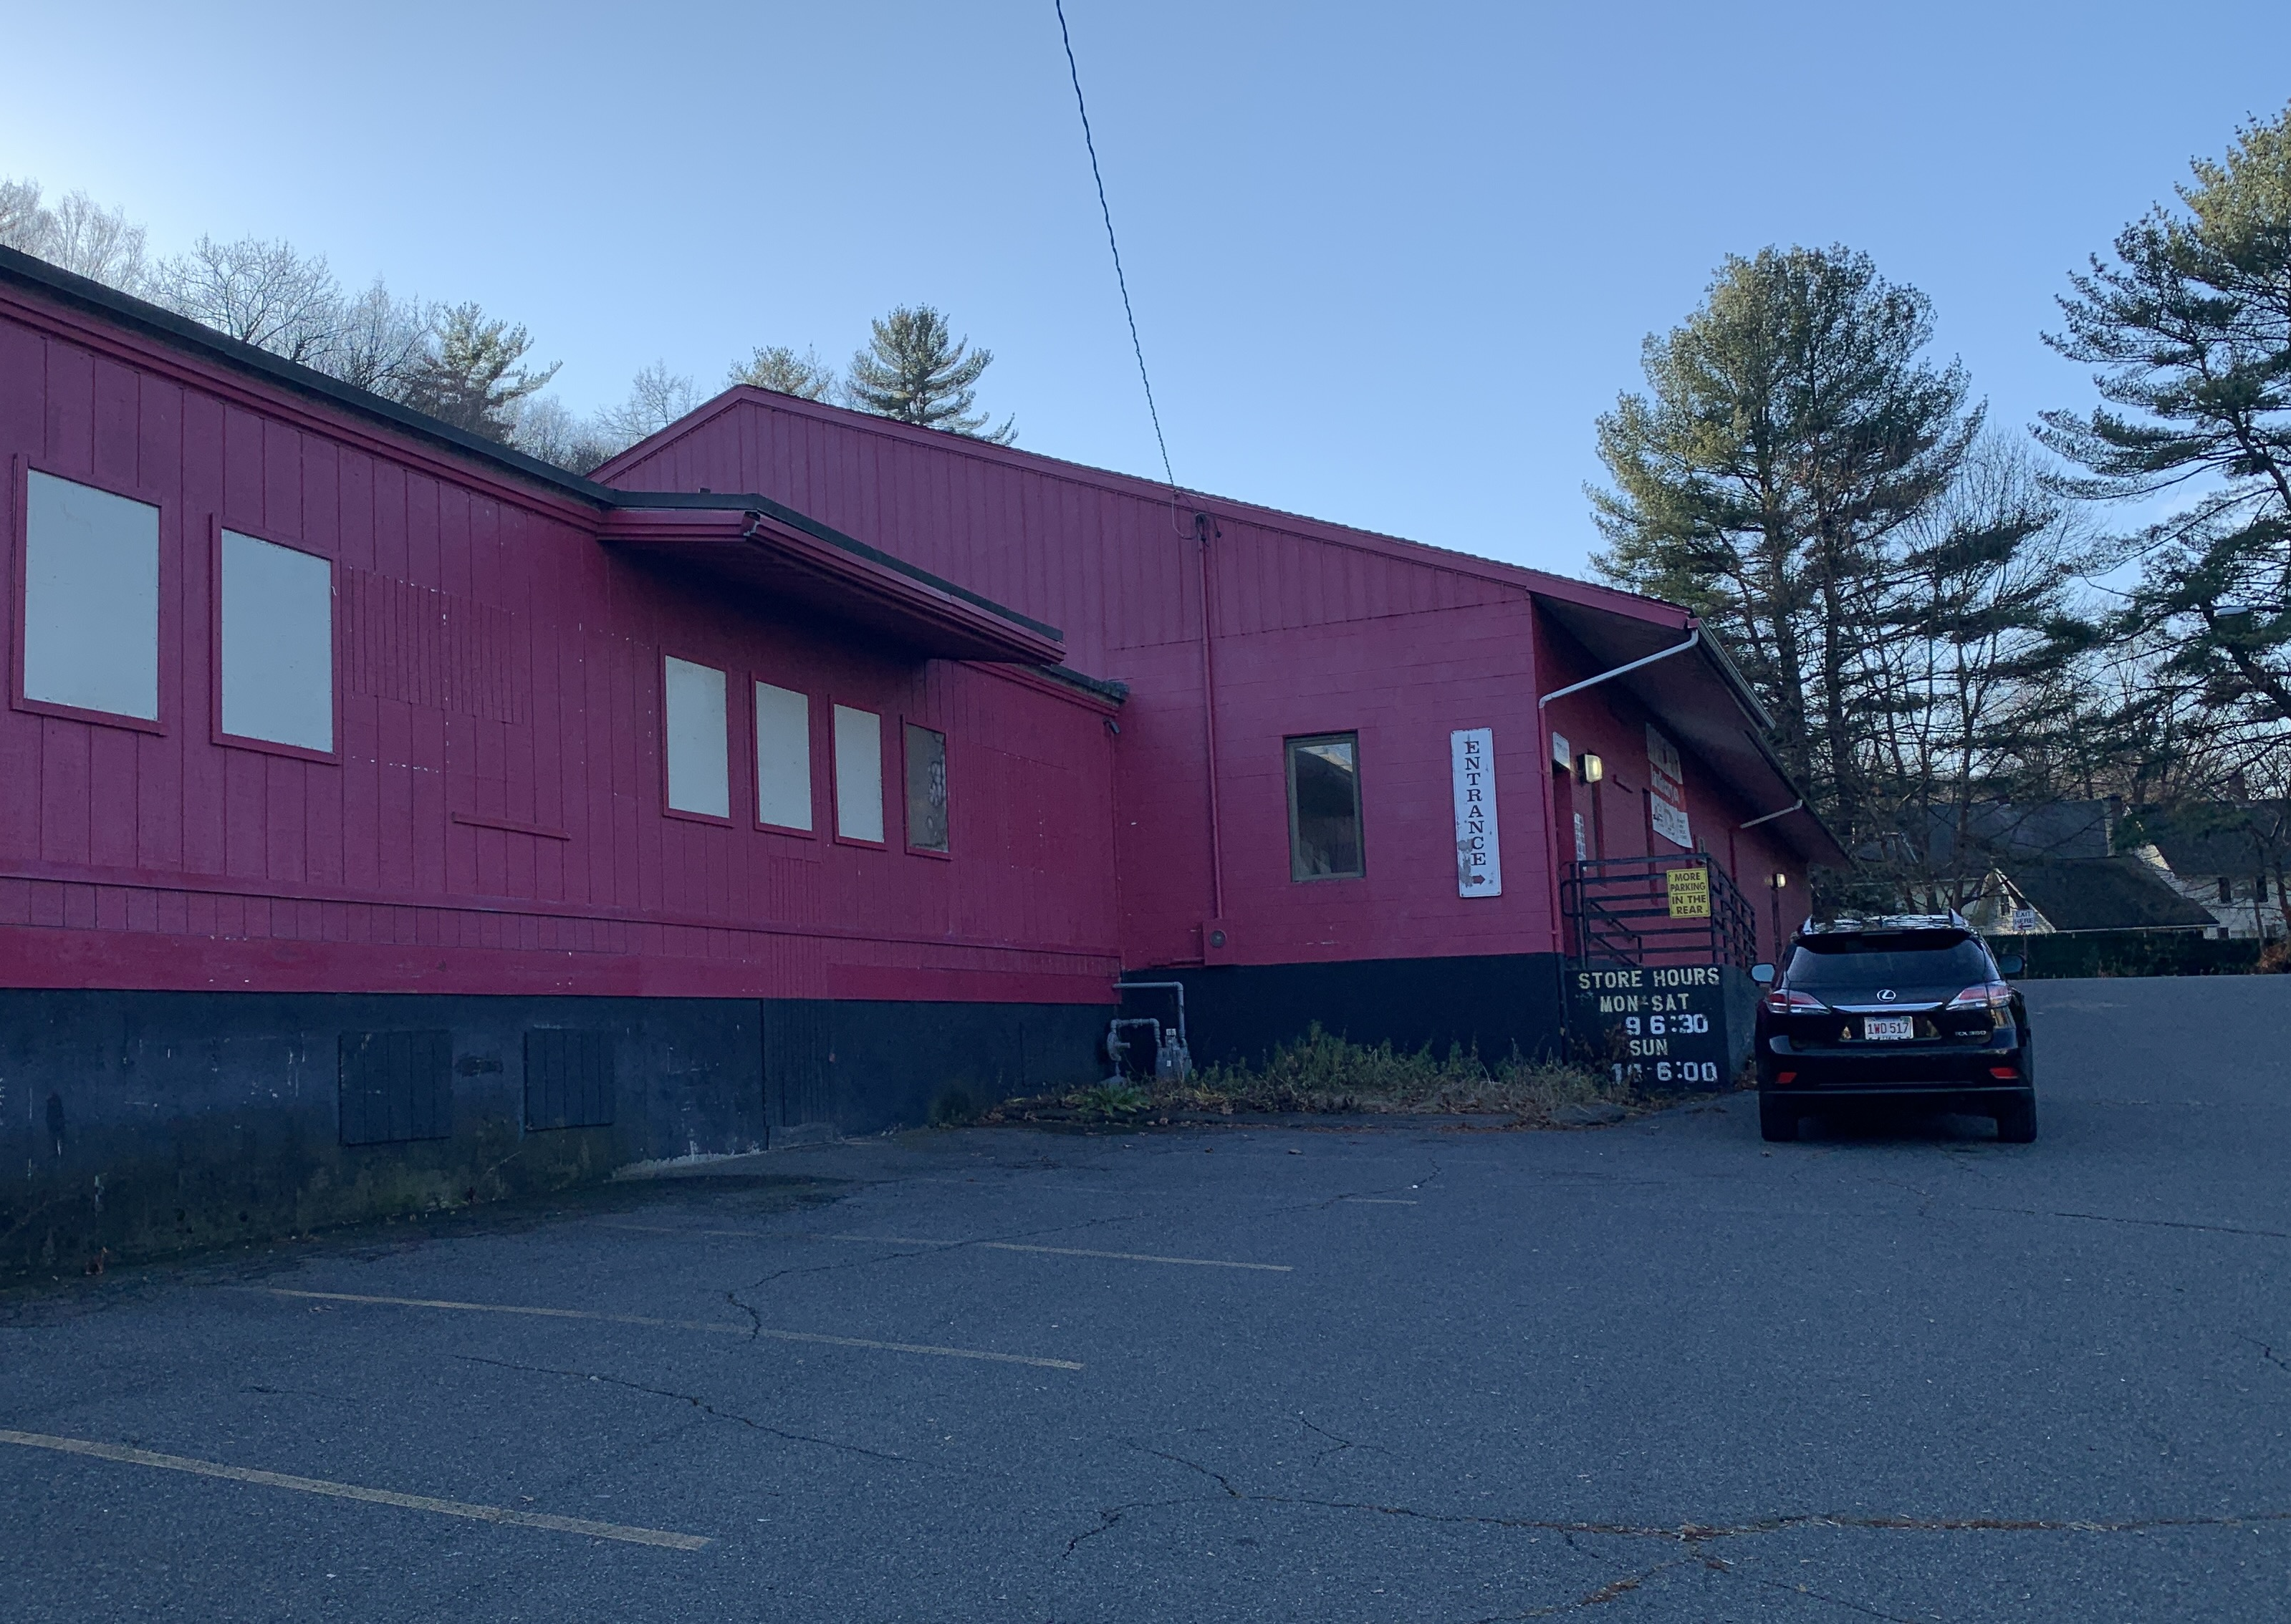
In June 2021 Community Action purchased the former Red Barn Grocery at 95 River Street in Greenfield, which has been vacant more than 2 years
The existing building was designed for grocery delivery and storage, which aligns with our plans to house a pantry
Needed repairs include replacing the roof, significant electrical upgrades, and addition of an entrance ramp

Slide 11
Proposed Design for the Community Resource Center @ River Street

Slide 12
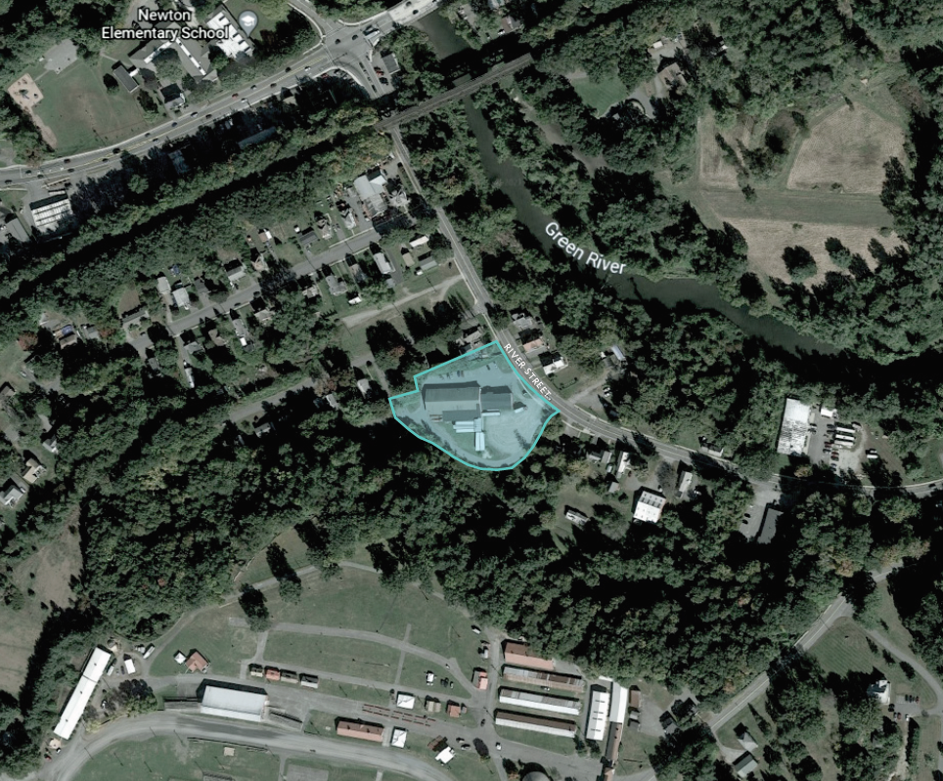
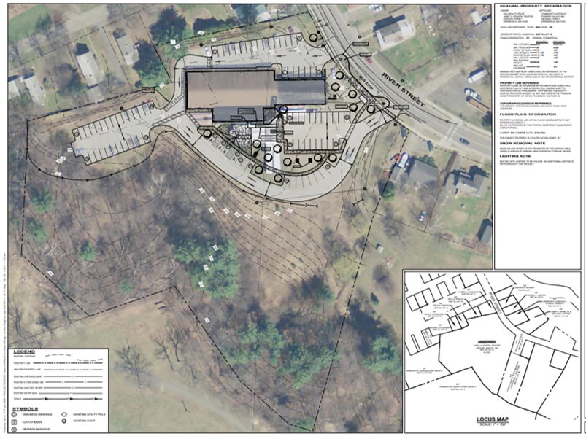
A Favorable Location
The site provides ample parking for employees and guests, while maintaining natural aspects, including wetlands. The site is outside of the flood plain, and landscape design will help absorb and clean rainwater.

Slide 13
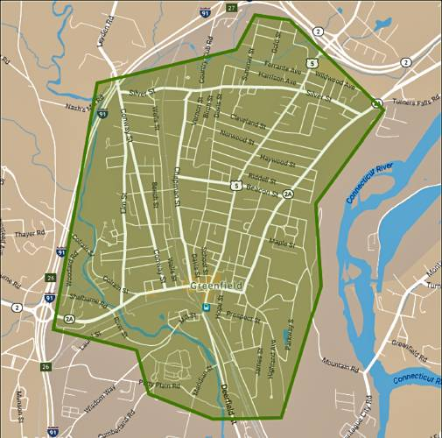
Improved Accessibility
Less than 1 mile from downtown Greenfield and I-91
Near the John W. Olver Transportation Center
Space to add a bus stop on a pre-existing route
393 Main St
95 River St

Slide 14
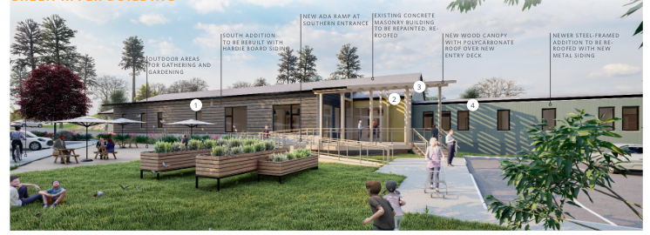
Increased sustainability
Renovation will promote environmental sustainability by reusing and upgrading an existing building, adding solar, and improving the site's climate resiliency
Owning the building will reduce occupancy costs over the long term so we can direct more funds to services

Slide 15
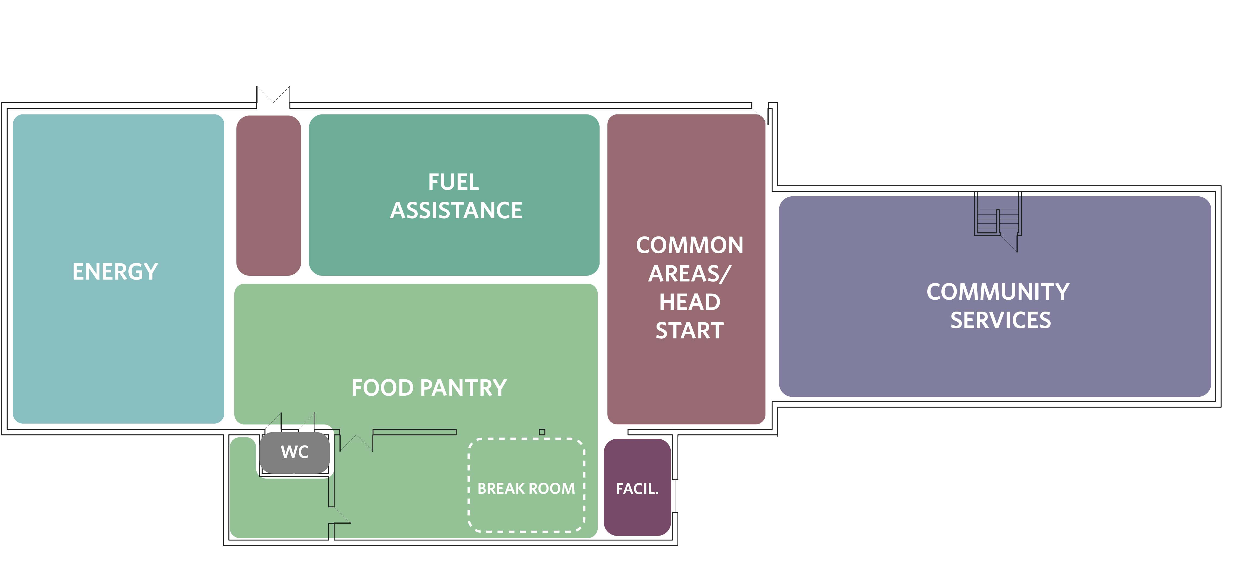
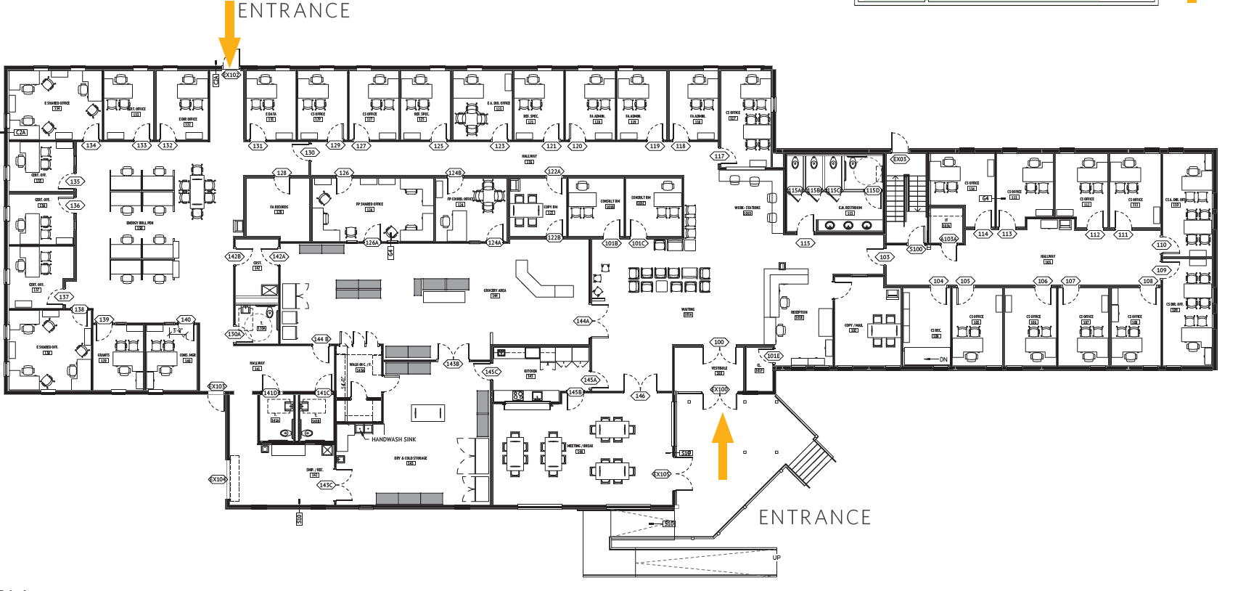
Proposed Layout
COMMON AREAS
15,500 SF to consolidate various client-facing programs into one centralized location centered around a food pantry
A welcoming main entry with covered deck & ramp
An open common space to welcome & guide visitors and connect programs together
A dry storage area for the pantry serviced by a garage door & loading area

Slide 16
Projected Sources & Uses
Sources |  |  | Uses
Mortgage | $2,000,000 |  | Site Acquisition | $485,000
USDA Grant | $1,000,000 |  | Renovation | $5,563,000
State Earmarks & UPP Grant | $806,250 |  | Sitework | $551,562
Fundraising to Date | $1,000,000 |  | Project Design | $195,657
Agency Reserves | $300,000 |  | General conditions & requirements | $498,199
Future Fundraising Planned | $276,277 |  | Permits, bonds, insurance | $55,902
Other Funding | $3,000,000 |  | Other (Furniture, Legal, Landscaping, Bus Stop, Generator, Contingency, Testing, Certifications, etc.) | $1,033,207
TOTAL | $8,382,527 |  | TOTAL | $8,382,527

